Slide 1

Chapter 4
Consumer
Choice

Slide 2

Chapter Four Overview
1. The Budget Constraint
2. Consumer Choice
3. Duality
4. Some Applications
5. Revealed Preference
Chapter Four

Slide 3
Key Definitions
Budget Set:
The set of baskets that are affordable
Budget Constraint:
The set of baskets that the consumer may purchase given the limits of the available income.
Budget Line:
The set of baskets that one can purchase when spending all available income.
Chapter Four

Slide 4
The Budget Constraint
Assume only two goods available: X and Y
Price of x: P_{x} ; Price of y: P_{y}
Income: I
Total expenditure on basket (X,Y): P_{x}X + P_{y}Y
The Basket is Affordable if total expenditure does not exceed total Income:
P_{X}X + P_{Y}Y ≤ I
Chapter Four

Slide 5
A Budget Constraint Example
Two goods available: X and Y
I = $10
P_{x} = $1
P_{y} = $2
All income spent on X → I/P_{x} units of X bought
All income spent on Y → I/P_{y} units of X bought
Budget Line 1:
1X + 2Y = 10
Or
Y = 5 – X/2
Slope of Budget Line = -P_{x}/P_{y} = -1/2
Chapter Four

Slide 6
A Budget Constraint Example
Y
Budget line = BL₁
I/P_{Y}= 5
•
A
-P_{X}/P_{Y} = -1/2
B
•
•
C
X
I/P_{X} = 10
Chapter Four

Slide 7
Budget Constraint
Location of budget line shows what the income level is.
Increase in Income will shift the budget line to the right.
More of each product becomes affordable
Decrease in Income will shift the budget line to the left.
less of each product becomes affordable
Chapter Four

Slide 8
A Budget Constraint Example
Y
Shift of a budget line
I = $12
P_{X} = $1
P_{Y} = $2
Y = 6 - X/2 …. BL₂
If income rises, the budget line shifts parallel to the right (shifts out)
If income falls, the budget line shifts parallel to the left (shifts in)
6
5
BL₂
BL₁
10
12
X
Chapter Four

Slide 9
Budget Constraint
Location of budget line shows what the income level is.
Increase in Income will shift the budget line to the right.
More of each product becomes affordable
Decrease in Income will shift the budget line to the left.
less of each product becomes affordable
Chapter Four

Slide 10
A Budget Constraint Example
Y
Rotation of a budget line
If the price of Y rises, the budget line gets flatter and the vertical intercept shifts down.
If the price of Y falls, the budget line gets steeper and the vertical intercept shifts up.
(Py here goes from 2 to 3)
I = $10
P_{X} = $1
P_{Y} = $3
Y = 3.33 - X/3 …. BL₂
6
5
BL₁
3.33
BL₂
10
X
Chapter Four

Slide 11
A Budget Constraint Example
Two goods available: X and Y
I = $800
P_{x} = $20
P_{y} = $40
All income spent on X → I/P_{x} units of X bought
All income spent on Y → I/P_{y} units of X bought
Budget Line 1:
20X + 40Y = 800
Or
Y = 20 – X/2
Slope of Budget Line = -P_{x}/P_{y} = -1/2
Chapter Four

Slide 12
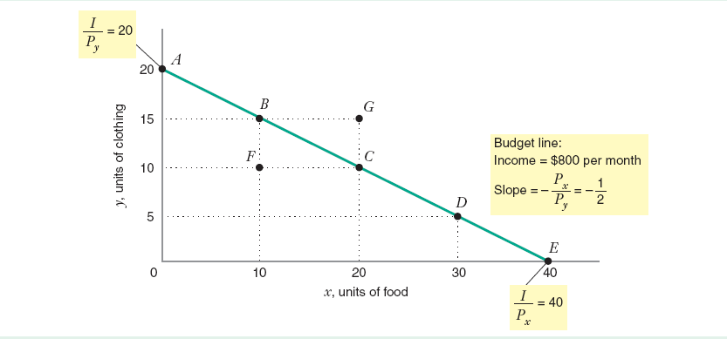
A Budget Constraint Example
Chapter Four

Slide 13
Consumer Choice
Assume:
➔ Only non-negative quantities
➔ "Rational” choice: The consumer chooses the basket that maximizes his satisfaction given the constraint that his budget imposes.
Consumer’s Problem:
Max U(X,Y)
Subject to: P_{x}X + P_{y}Y < I
Chapter Four

Slide 14
Interior Optimum
Interior Optimum: The optimal consumption basket is at a point where the indifference curve is just tangent to the budget line.
A tangent: to a function is a straight line that has the same slope as the function…therefore….
MRSx,y = MU_{x}/MU_{y} = P_{x}/P_{y}
“The rate at which the consumer would be willing to exchange X for Y is the same as the rate at which they are exchanged in the marketplace.”
Chapter Four

Slide 15
Interior Consumer Optimum
Y
•
B
Preference Direction
•
Optimal Choice (interior solution)
IC
•
C
BL
0
X
Chapter Four

Slide 16
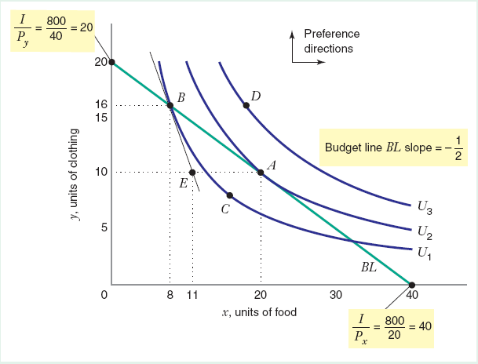
Interior Consumer Optimum
Chapter Four

Slide 17
Interior Consumer Optimum
Assumptions
U (X,Y) = XY and MU_{x} = Y while MU_{y} = X
I = $1,000
P = $50 and P = $200
Basket A contains (X=4, Y=4)
Basket B contains (X=10, Y=2.5)
Question:
Is either basket the optimal choice for the consumer?
X
Y
Basket A:
MRS_{x,y} = MU_{x}/MU_{y} = Y/X = 4/4 = 1
Slope of budget line = -P_{x}/P_{y} = -1/4
Basket B:
MRS_{x,y} = MU_{x}/MU_{y} = Y/X = 1/4
Chapter Four

Slide 18
Interior Consumer Optimum
Y
Example
50X + 200Y = I
•
2.5
U = 25
0
X
10
Chapter Four

Slide 19
Equal Slope Condition
MU_{x}/P_{x} = MU_{y}/P_{y}
“At the optimal basket, each good gives equal bang for the buck”
Now, we have two equations to solve for two unknowns (quantities of X and Y in the optimal basket):
1. MU_{x}/P_{x} = MU_{Y}/P_{Y}
2. P_{x}X + P_{y}Y = I
Chapter Four

Slide 20
Contained Optimization
What are the equations that the optimal consumption basket must fulfill if we want to represent the consumer’s choice among three goods?
MU / P = MU / P is an example of “marginal reasoning” to maximize
P X + P Y = I reflects the “constraint”
X
X
Y
Y
X
Y
Chapter Four

Slide 21
Contained Optimization
U(F,C) = FC
P_{F} = $1/unit
P_{C} = $2/unit
I = $12
Solve for optimal choice of food and clothing
Chapter Four

Slide 22
Some Concepts
Corner Points: One good is not being consumed at all – Optimal basket lies on the axis
Composite Goods: A good that represents the collective expenditure on every other good except the commodity being considered
Chapter Four

Slide 23
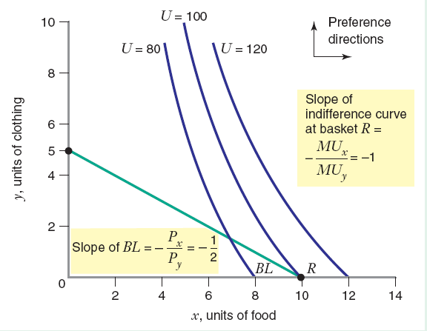
Some Concepts
Chapter Four

Slide 24
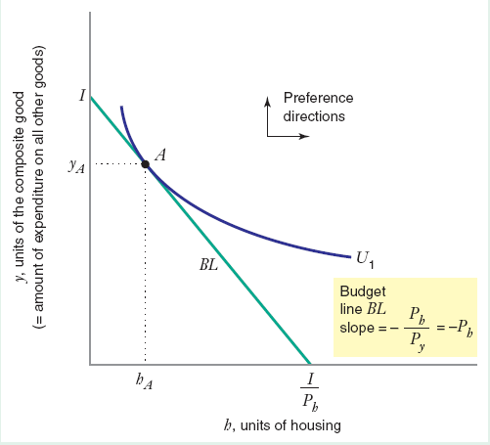
Some Concepts
Chapter Four

Slide 25
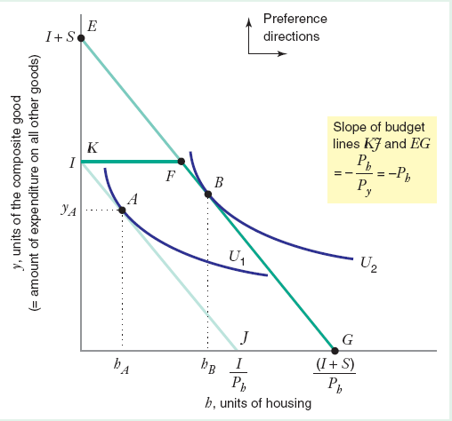
Some Concepts
Chapter Four

Slide 26
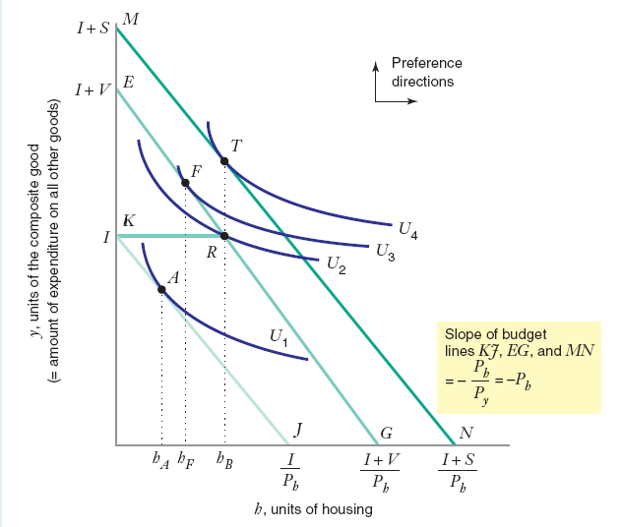
Some Concepts
Chapter Four

Slide 27
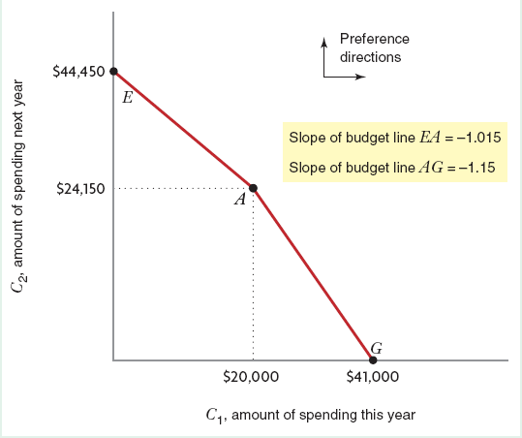
Some Concepts
Chapter Four

Slide 28
Duality
The mirror image of the original (primal) constrained optimization problem is called the dual problem.
Min P_{x}X + P_{y}Y
(X,Y) subject to: U(X,Y) = U*
where: U* is a target level of utility.
If U* is the level of utility that solves the primal problem, then an interior optimum, if it exists, of the dual problem also solves the primal problem.
Chapter Four

Slide 29
Optimal Choice
Y
Example: Expenditure Minimization
•
Optimal Choice (interior solution)
U = U*
Decreases in
expenditure level
P_{X}X + P_{Y}Y = E*
0
X
Chapter Four

Slide 30
Optimal Choice
Y
Example: Expenditure Minimization
50X + 200Y = E
25 = XY (constraint)
Y/X = 1/4 (tangency condition)
•
2.5
U = 25
0
X
10
Chapter Four

